Slide 1








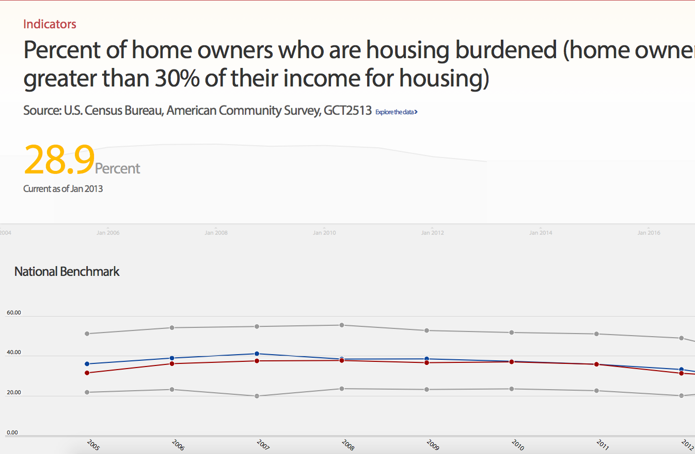
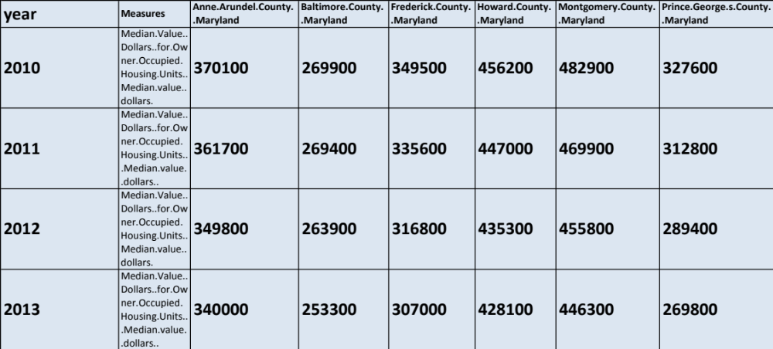
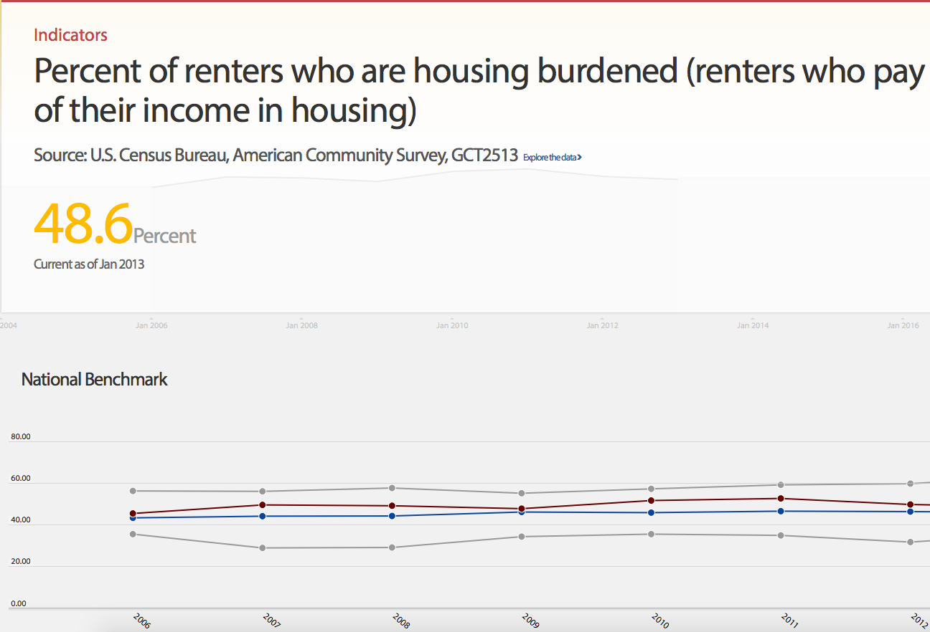
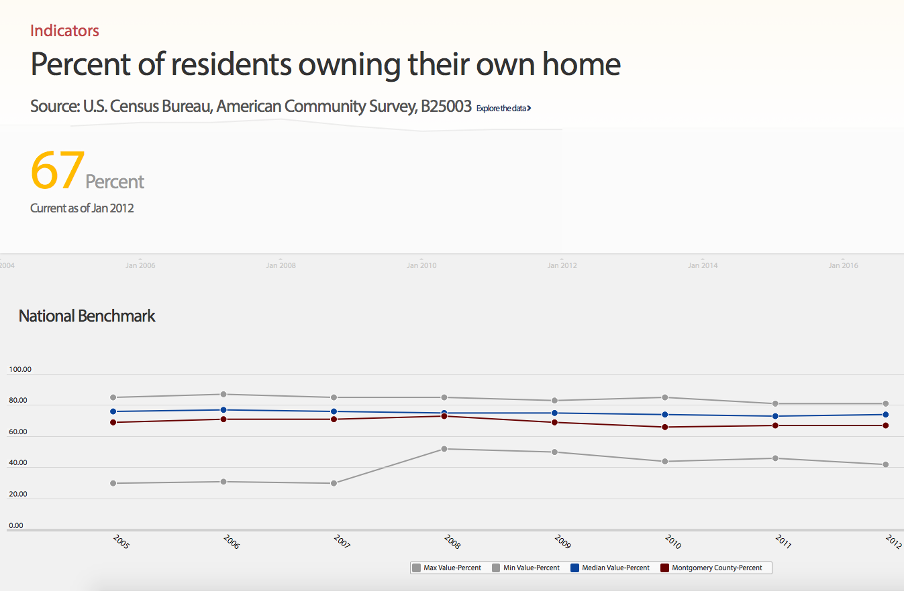
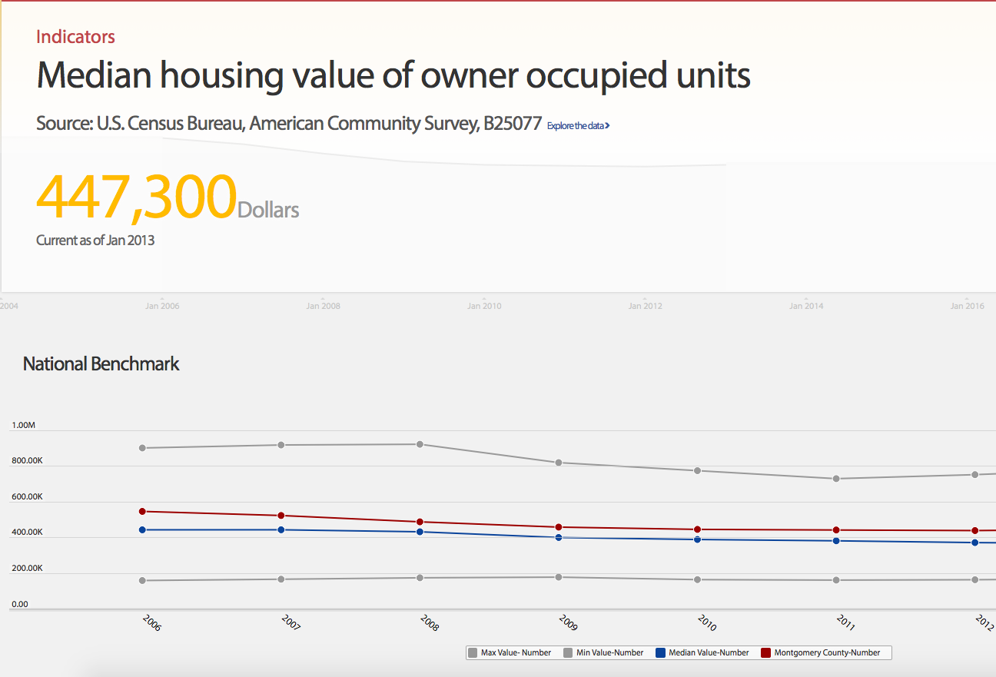
Benchmarking Local Governments through Open Data
Using the US Census American Community Survey & R
Developer: Robert Pickering | Professor: Dr. Kathy Weaver
Client: Montgomery County – Office of the County Executive – CountyStat Team
Introduction
The County Stat Team is responsible for providing quality of life measures benchmarked against other counties in the United States.
Problem Statement
Use R scripting language to retrieve 10 data sets from the US Census American Community Survey to benchmark quality of life measures and service delivery.
Problem Analysis
Evaluate alternative solutions:
  ACS-R Package
  CitySDK
  Generic API Call
Provide options to client.
Approach
Use ACS-R Package
Create multiple customizable scripts for maximum flexibility
Enable flexible geography creation for custom data retrieval
Background
Data manually retrieved from the US Census Bureau to populate website
Data used to
  make smarter decisions
  champion transparency and accountability
  achieve better outcomes for our residents
ACS DATA:
2006 -- 2010 ;
Estimates w/90% confidence intervals;
for different intervals, see confint()
Median Value (Dollars) for Owner-Occupied Housing Units: Median value (dollars)
Anne Arundel County, Maryland 370100 +/- 1985
Baltimore County, Maryland 269900 +/- 1953
Frederick County, Maryland 349500 +/- 3629
Howard County, Maryland 456200 +/- 4452
Montgomery County, Maryland 482900 +/- 2460
Prince George's County, Maryland 327600 +/- 1983
Accomplishments
Streamlined data acquisition and formatting process through automation
Improved data quality through employing repeatable process
Developed solution entirely in R
Goals
Reduce labor costs by implementing sustainable automated data retrieval
Reduce human error

